Slide 1


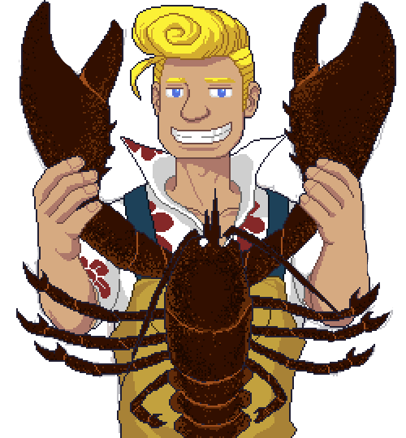




Object Oriented Programming
for
Game Development
Class, Object, Inheritance, Association, Aggregation, Composition
Class Diagram, Polymorphism, Encapsulation

Slide 2
Object-oriented programming (OOP) is a programming paradigm based on the concept of "objects“.
Object Oriented
Programming
(OOP)
Attribute
Method

Slide 3

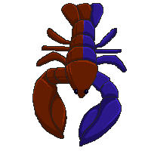
Attribute | speed color propeller | claw color weight
Behavior | beep() swim() brake() | eat() walk() clamp()

Slide 4
We will discuss about:
Class vs Object
Composition
Aggregation
Inheritance
Association
Class Diagram
Polymorphism
Encapsulation

Slide 5
Class vs Object
Class: the “blueprint” of an object which contains attributes and behaviors
Object: representation of class

Slide 6

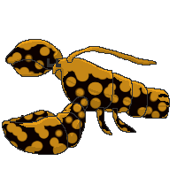

Class:
Lobster
Object:
Blue Lobster
Split Colored Lobster
Calico Lobster
Albino Lobster

Slide 7




Class:
Lobstermen
Object:
Arsyad
Kelu
Joy
Yugo

Slide 8


Class:
Ship
Object:
Ship 1
Ship 2
Ship 3

Slide 9


Slide 10
Next…
Class vs Object
Composition
Aggregation
Inheritance
v
Association
Class Diagram

Slide 11
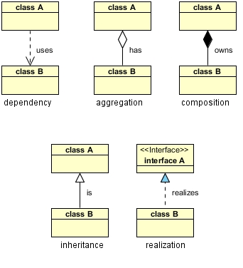

Slide 12

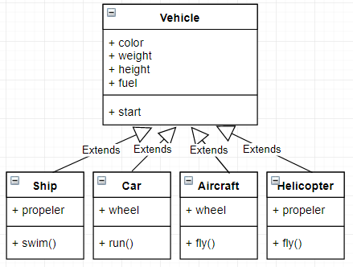
Inheritance
Superclass
Subclass

Slide 13
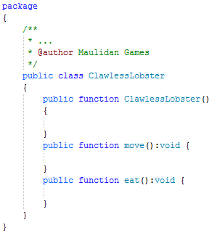
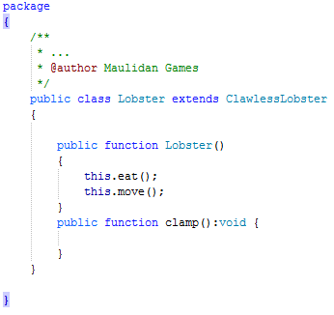

Slide 14

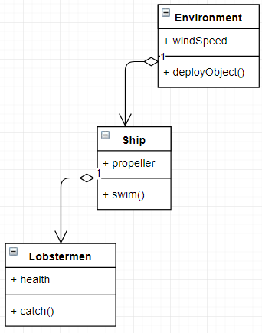
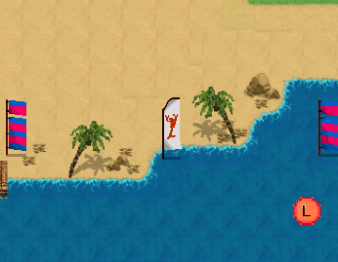
Aggregation

Slide 15
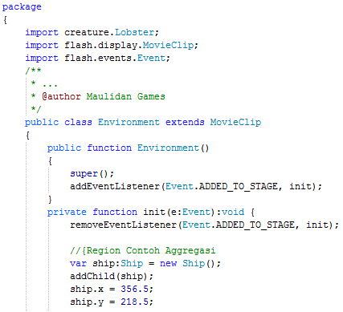
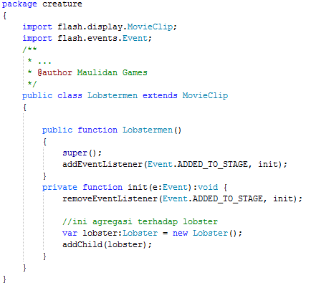

Slide 16
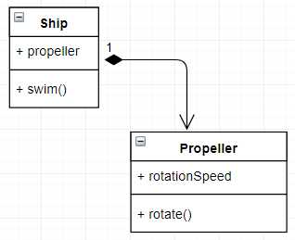
Composition

Slide 17
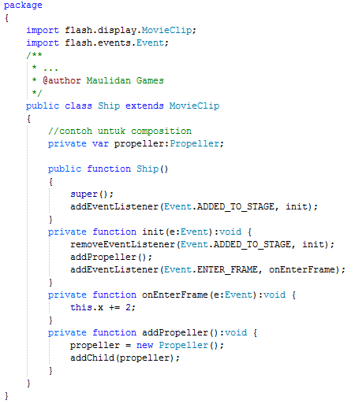
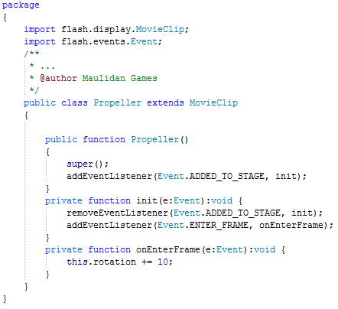

Slide 18
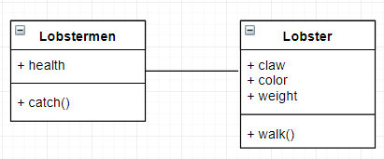
Association

Slide 19
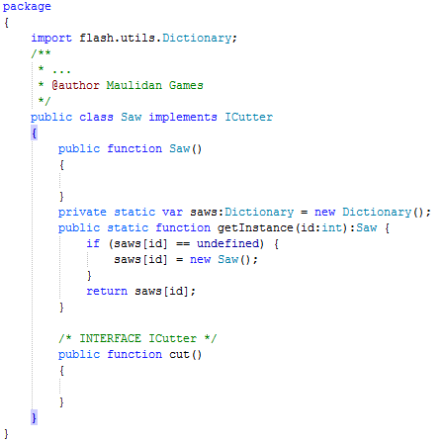
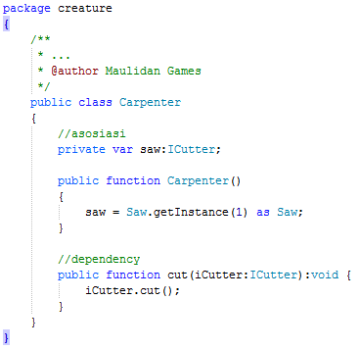

Slide 20
Task:
Create a class diagram based on this picture!

Slide 21
Next…
Polymorphism
Encapsulation
v

Slide 22
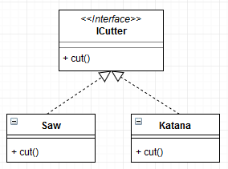
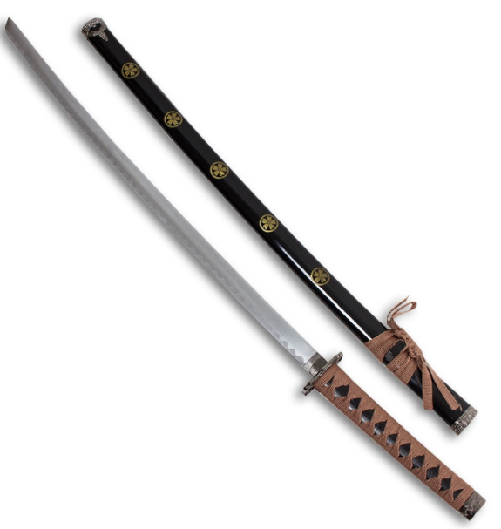

Polymorphism
Overriding

Slide 23

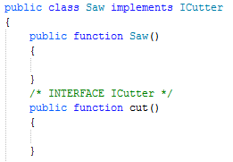
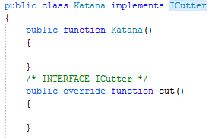

Slide 24
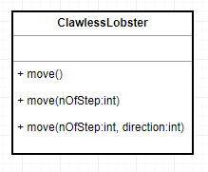
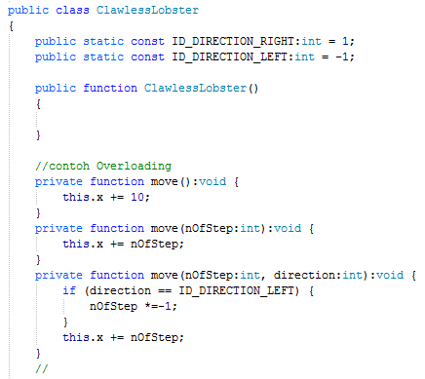
Polymorphism
Overloading

Slide 25
Encapsulation
Access Modifier
Public
Private
Protected
Internal

Slide 26
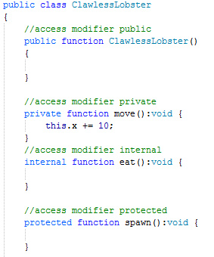
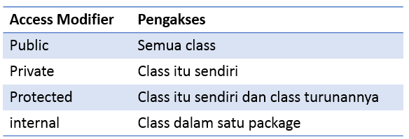
Access Modifier

Slide 27

Ada Pertanyaan?

